Slide 1
Cooking with AWS and Splunk
Module 7: Setting up ELB / HWF Tier
Kam Amir | Splunk Cloud Architect

Slide 2
Setup ELB / HWF Tier
Setting up Elastic Load Balancer and a Heavy Weight Forwarder Tier
Setup Network to support Load Balance
Build HWF using CF Template / Manual Build
Collect ELB Logs using SQS-S3 mechanism
Setup HEC Tokens across HWF’s

Slide 3
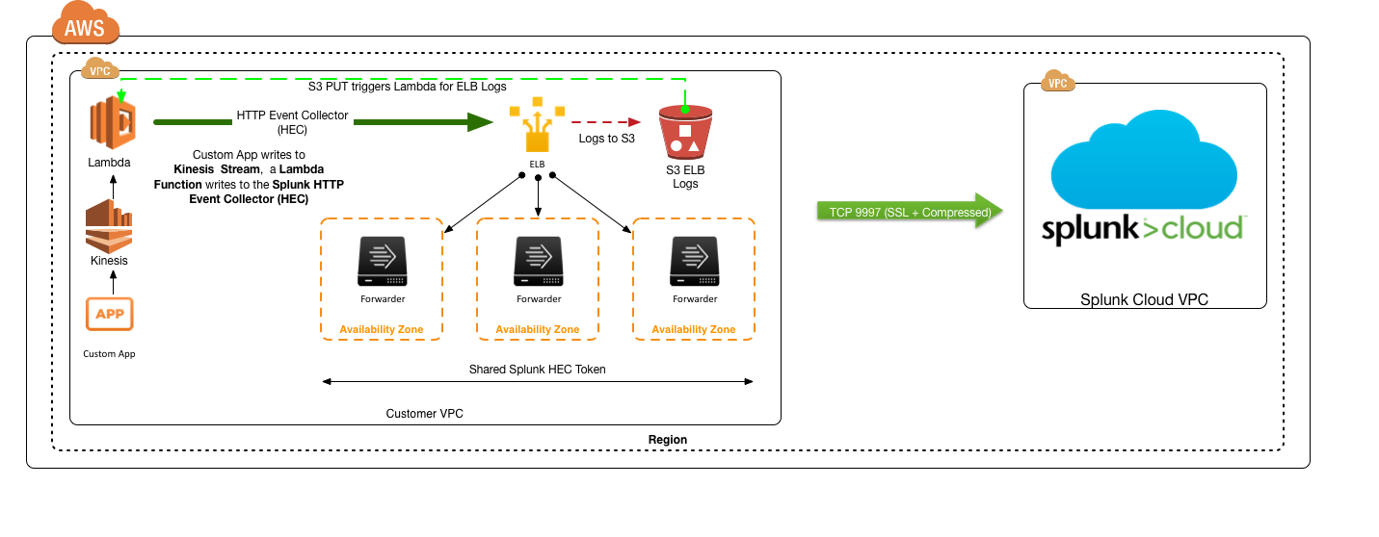
Architecture for Deployment

Slide 4
Setup AWS Networking
Setup networking for Elastic Load Balancing

Slide 5
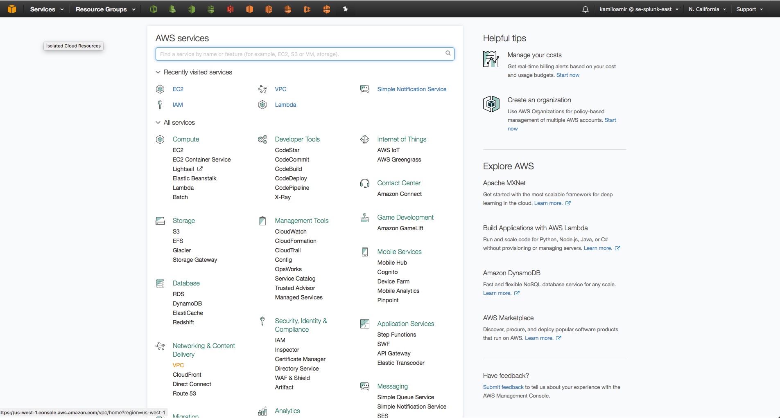
Setup Network
Select VPC under Network & Content Delivery
Select VPC

Slide 6
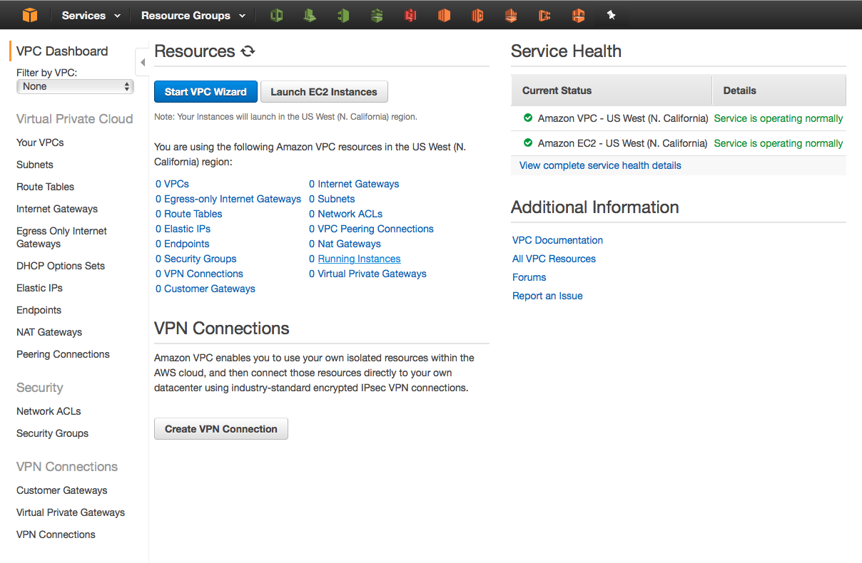
Setup Network: Create VPC
Start VPC Wizard
Click Here

Slide 7
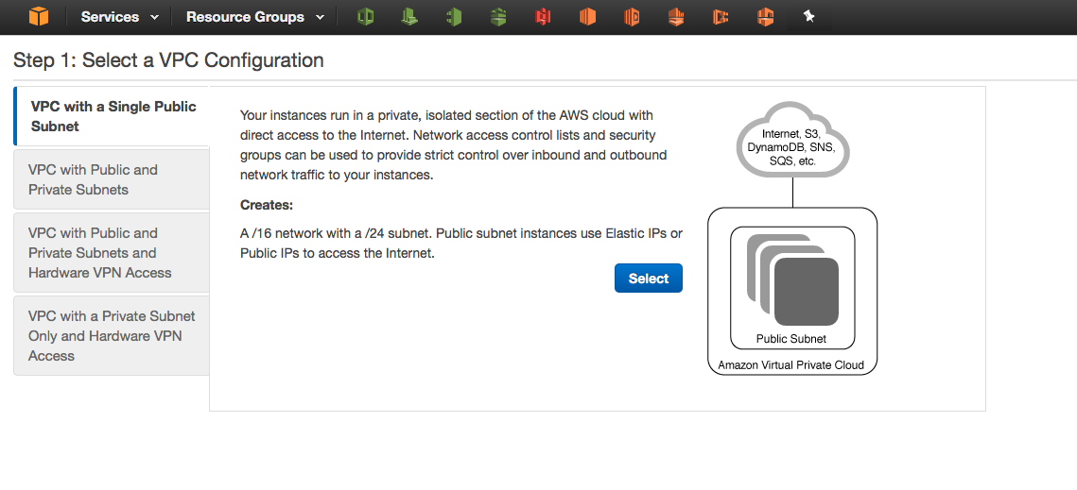
Setup Network: Create VPC
Select Single VPC & Public Subnet
Click Here

Slide 8
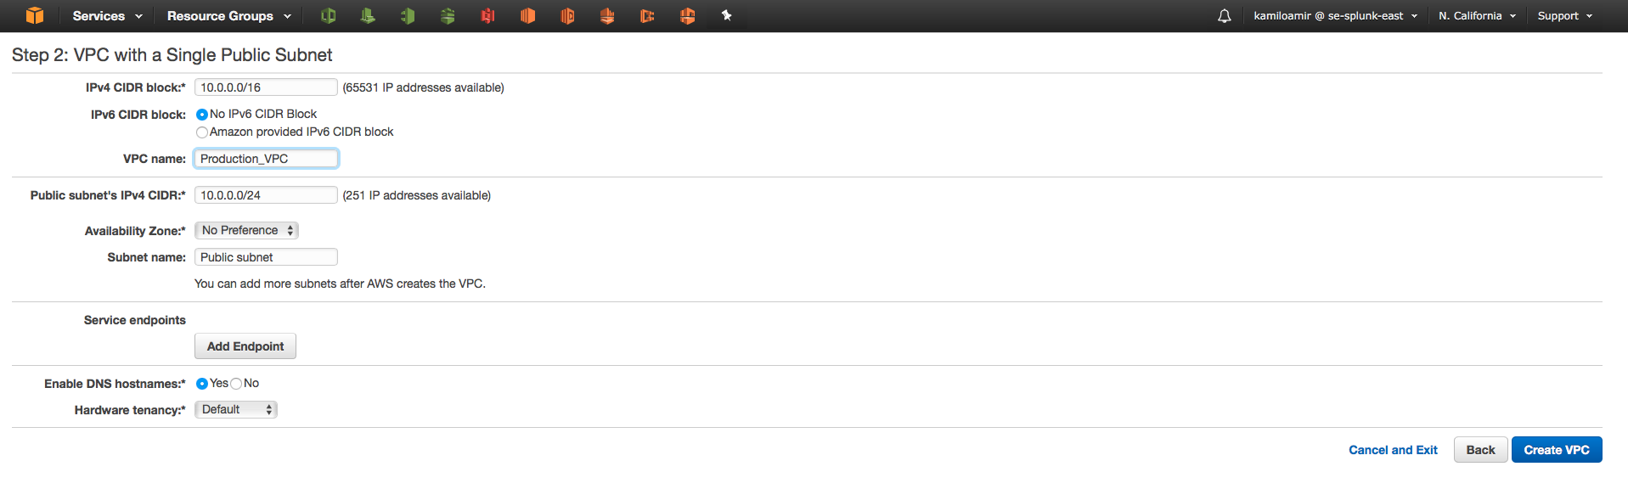
Setup Network: Create VPC
Create VPC
Click Here
Click OK

Slide 9
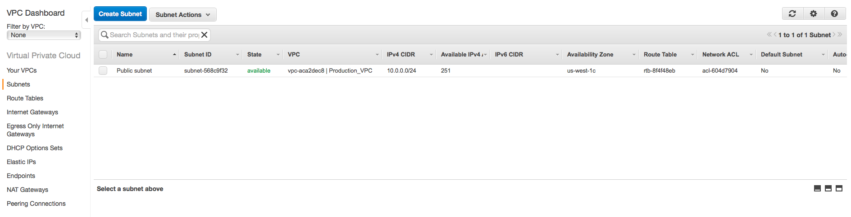
Setup Network: Create Second Subnet
Click Subnets on the left hand side then click Create Subnet
2) Create Subnets
1) Click Subnets

Slide 10
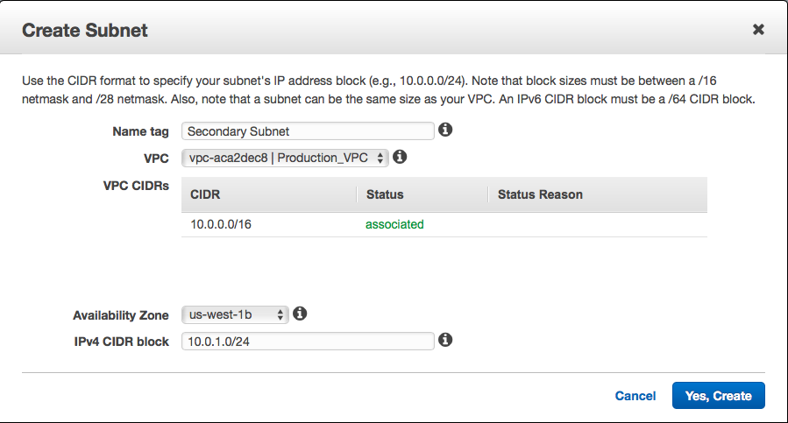
Setup Network: Create Second Subnet
Select Availability Zone and CIDR
Select Second Availability Zone (AZ)
Create Ipv4 CIDR block within existing VPC

Slide 11
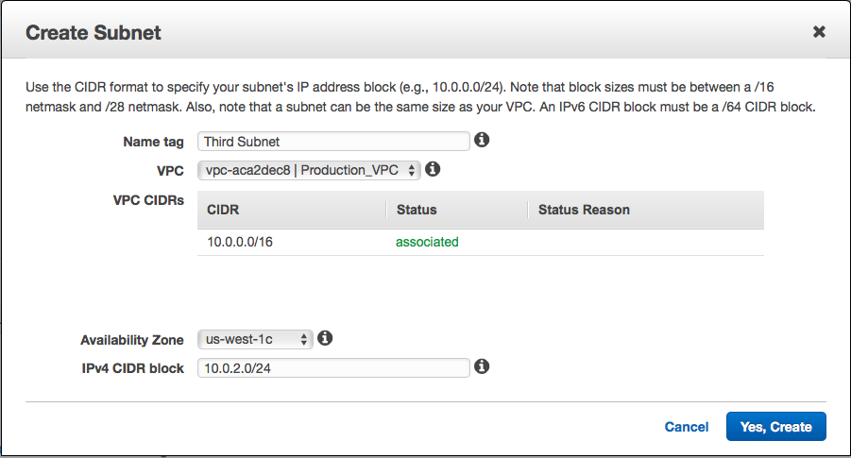
Setup Network: Create Third Subnet
Select Availability Zone and CIDR
Select Second Availability Zone (AZ)
Create Ipv4 CIDR block within existing VPC

Slide 12
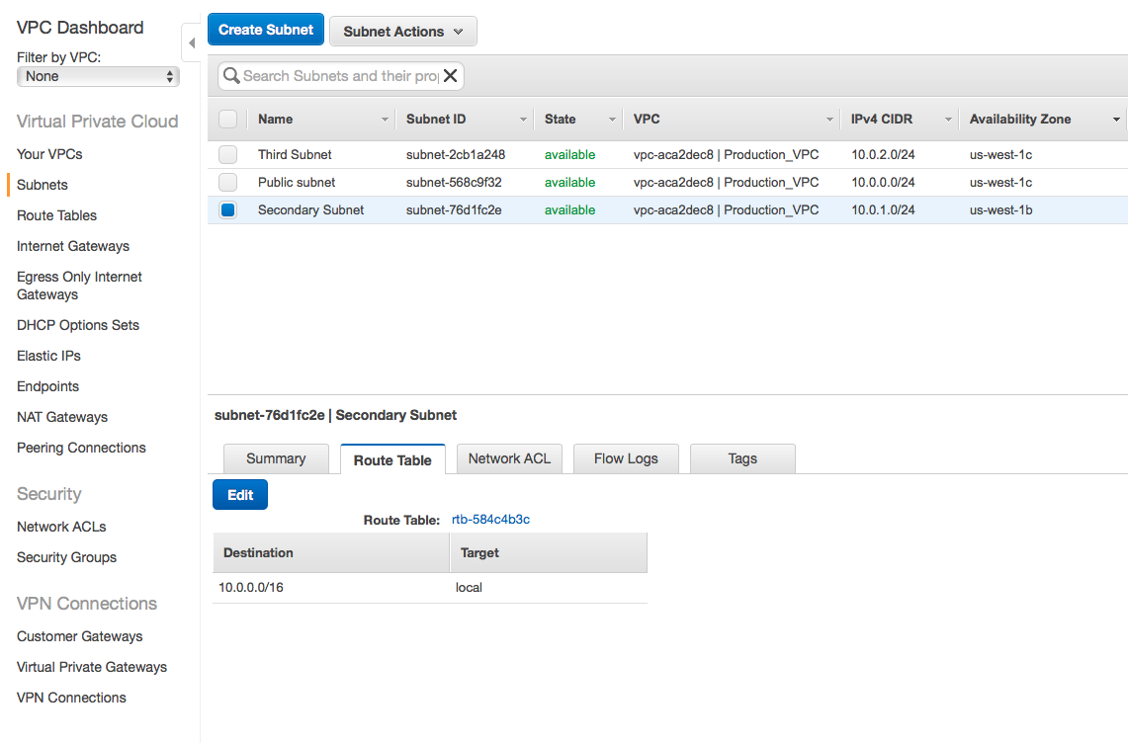
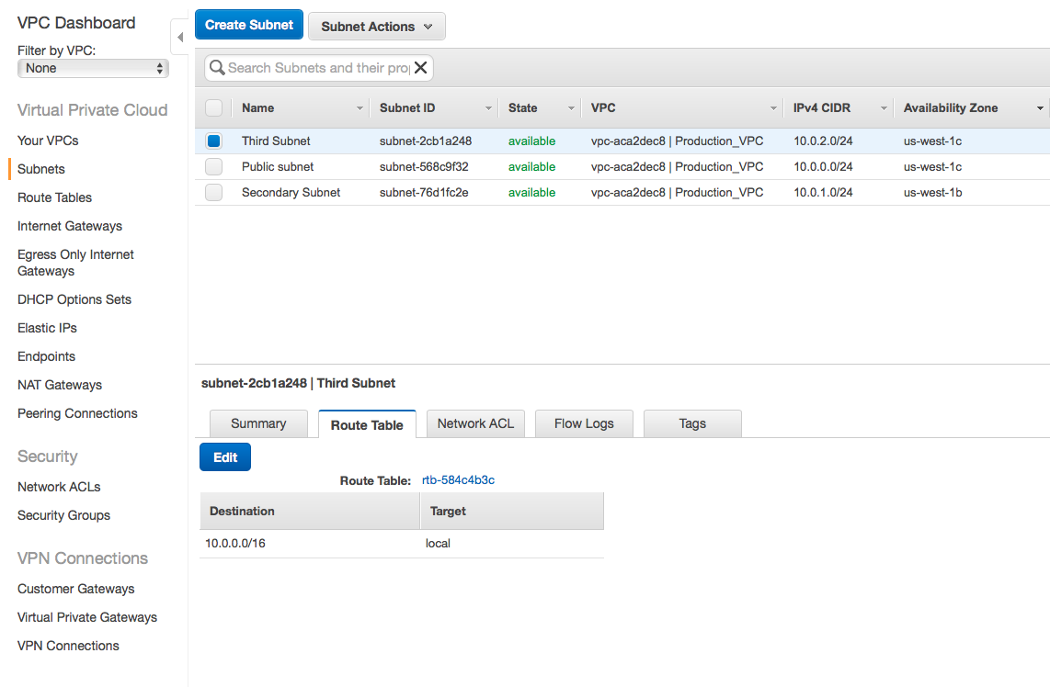
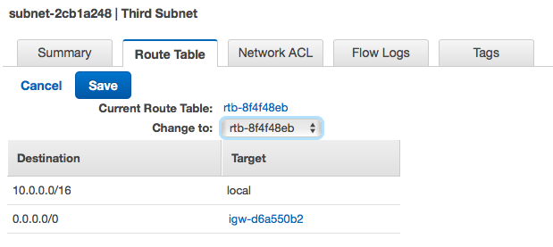
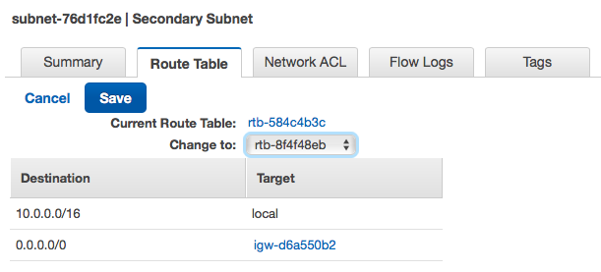
Setup Network: Create Route Table for Subnets
Edit the Route Table in newly created subnets and add internet gateway
Click EDIT
Select the route table with the internet gateway attached and click Save.

Slide 13
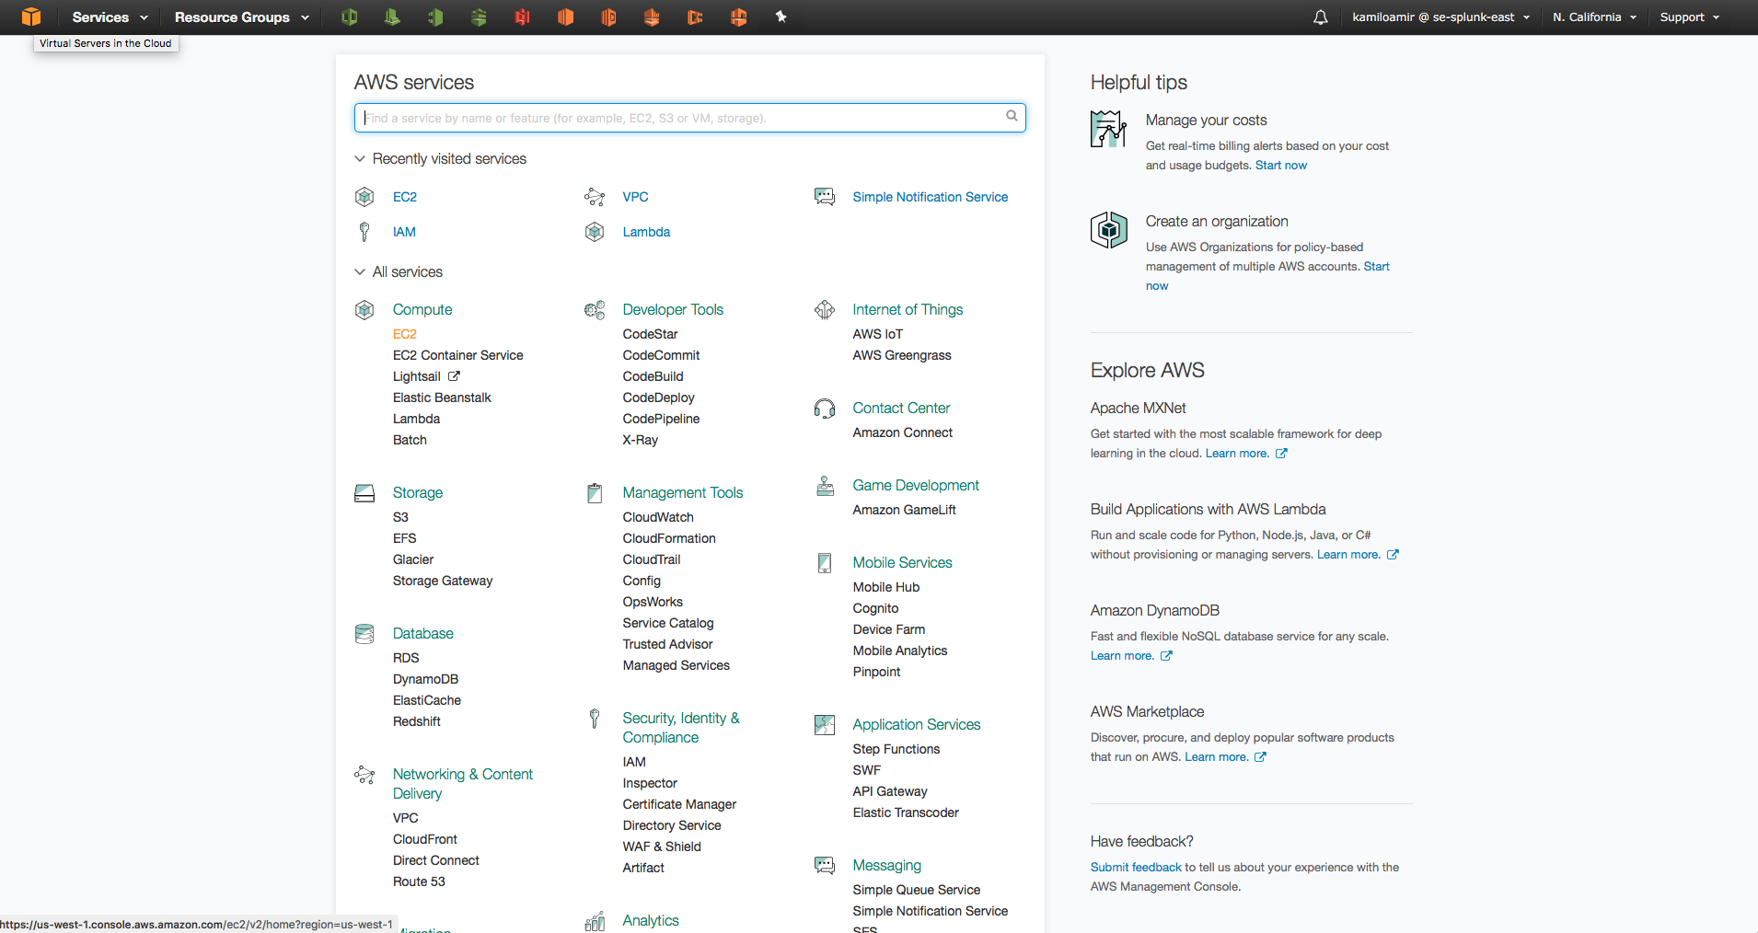
Deploy EC2 Instances
Deploy EC2 instances into each AZ

Slide 14
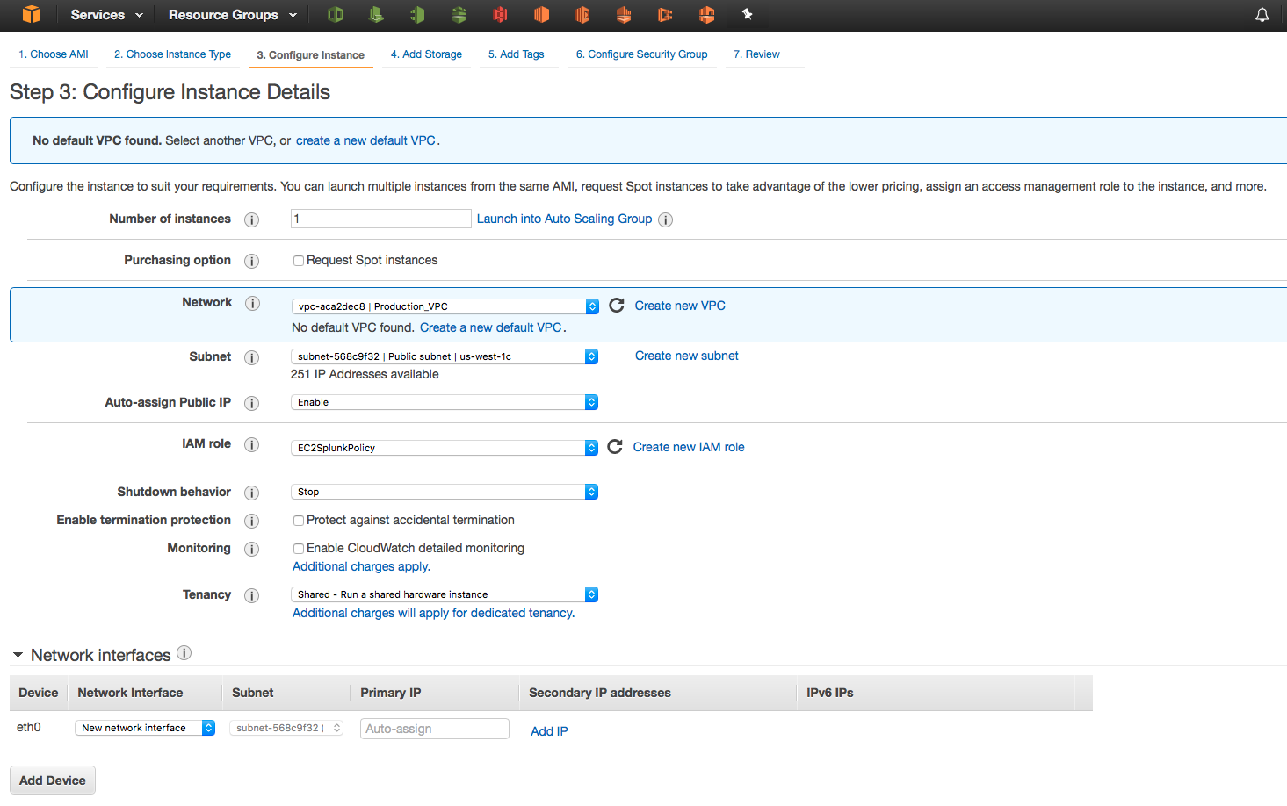
Deploy EC2 Instances
Deploy EC2 instances into each AZ
Select Subnet
Enable
Select IAM Role

Slide 15
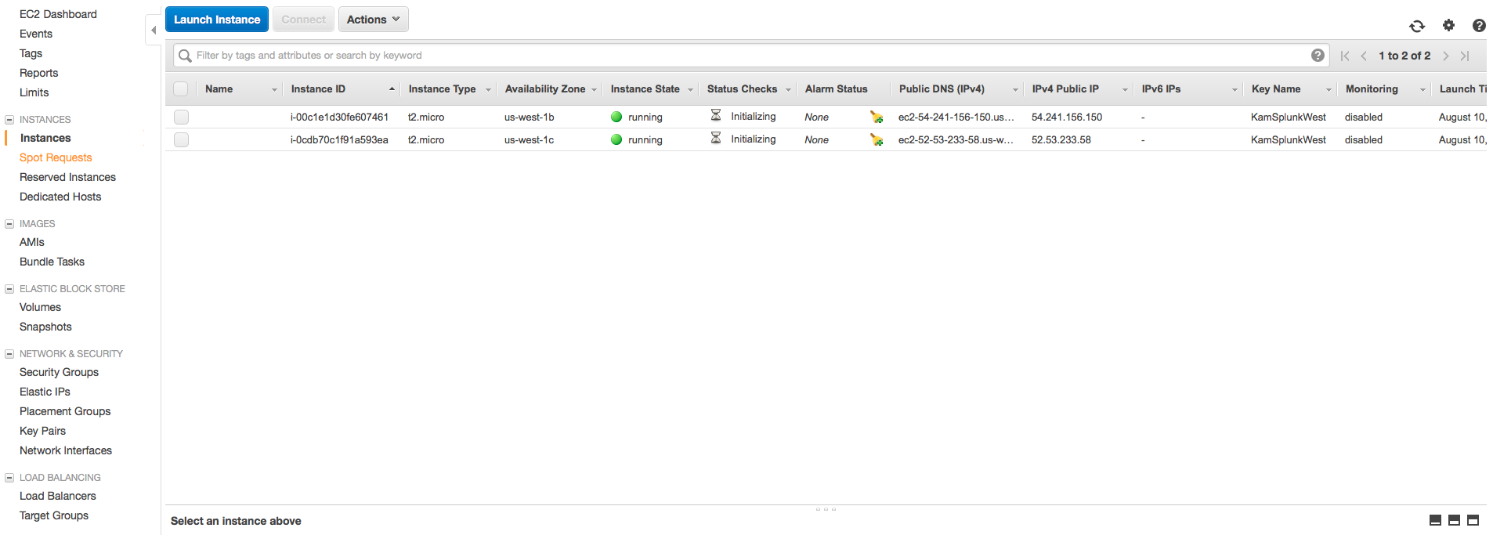
Setup Elastic Load Balancer (ELB)
Once Instances are running, click Load Balancers
Click Here

Slide 16
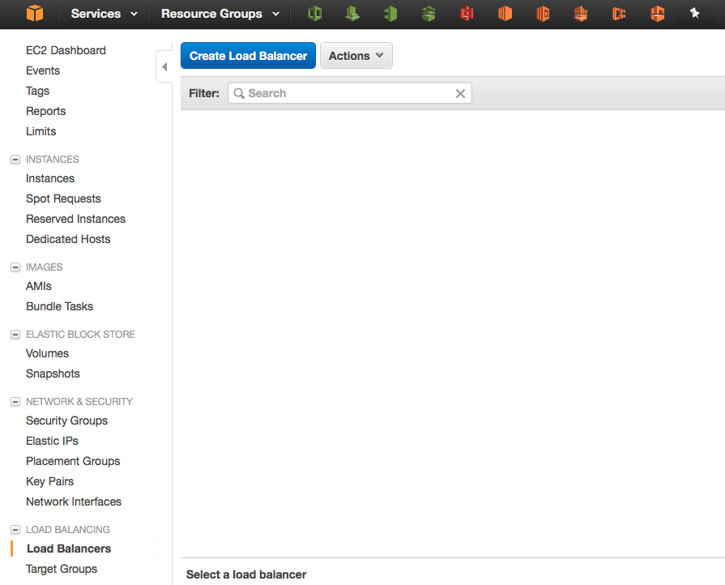
Setup Elastic Load Balancer (ELB)
Once Instances are running, click Load Balancers
Click Here

Slide 17
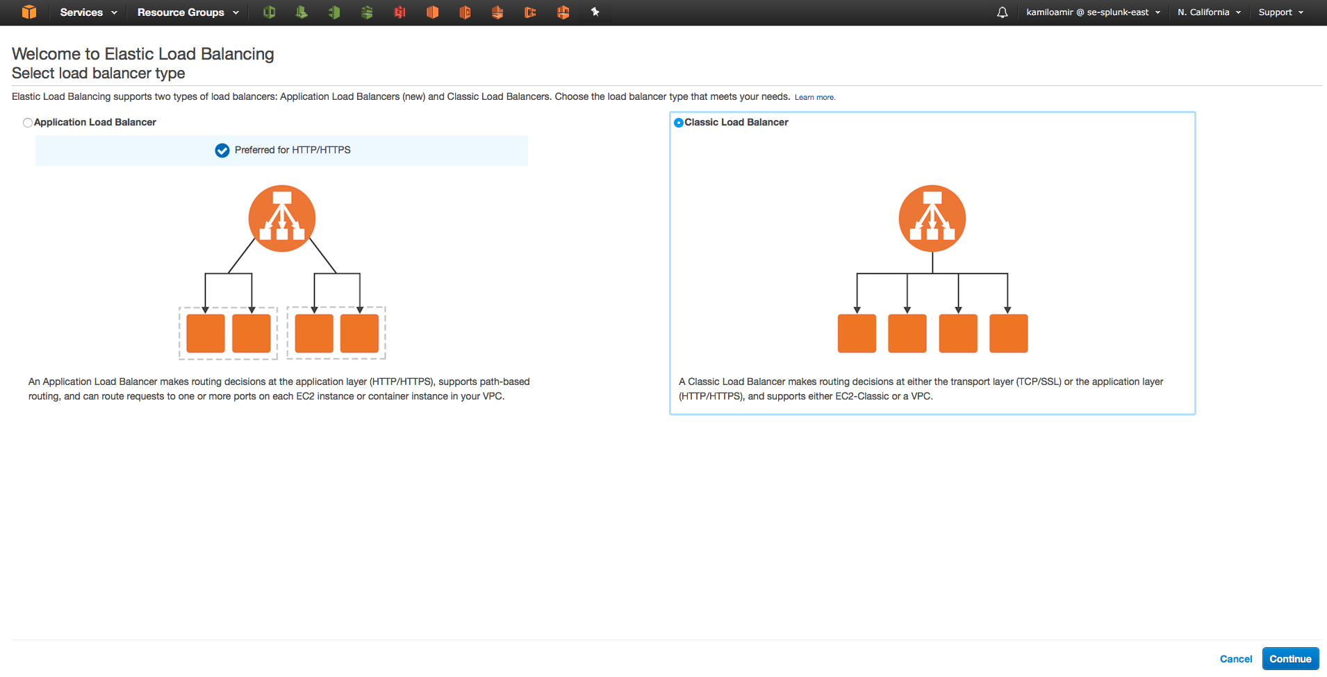
Setup Elastic Load Balancer (ELB)
Select Classic Load Balancer
Click Continue

Slide 18
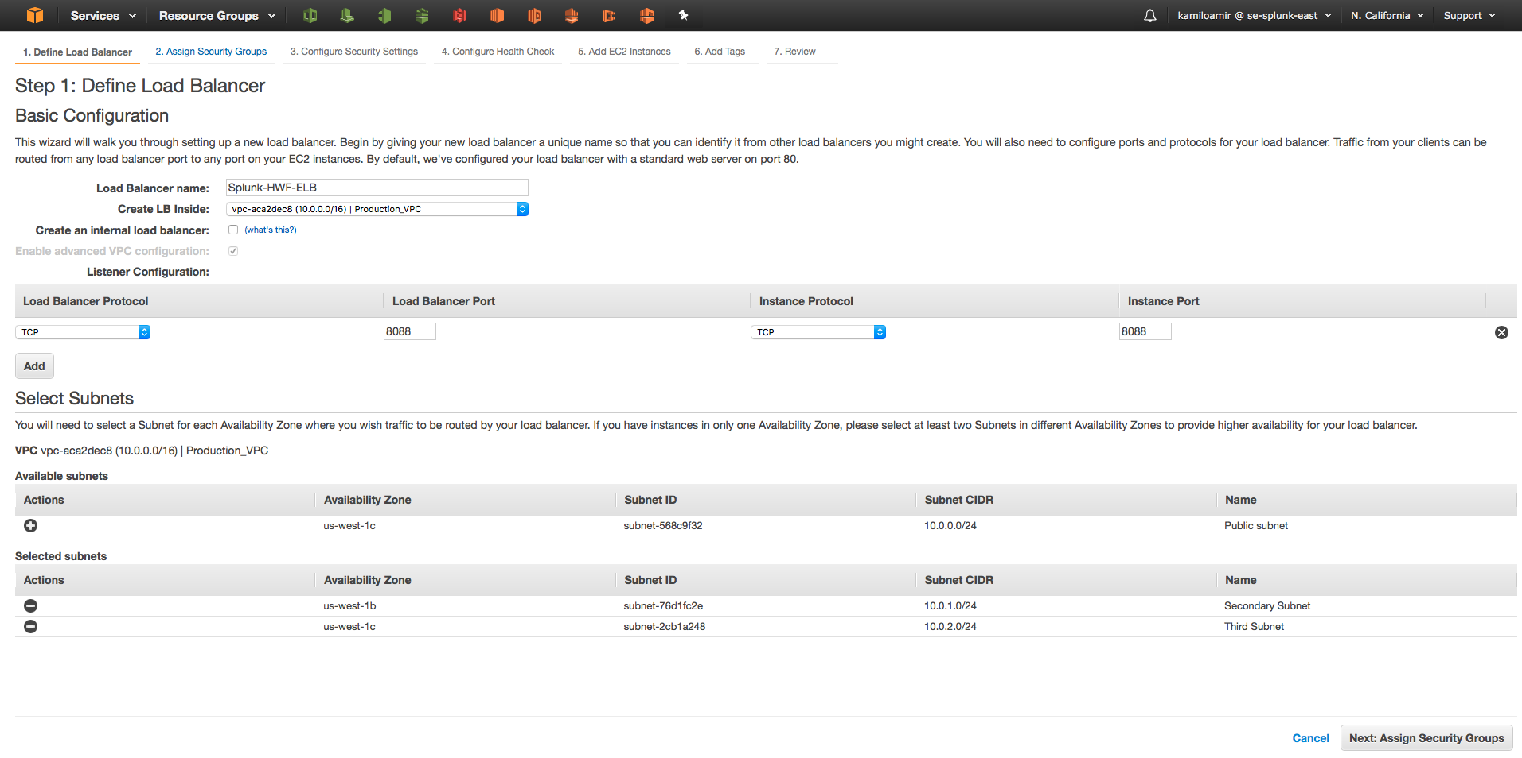
Setup Elastic Load Balancer (ELB)
Select Classic Load Balancer
Click Continue

Slide 19
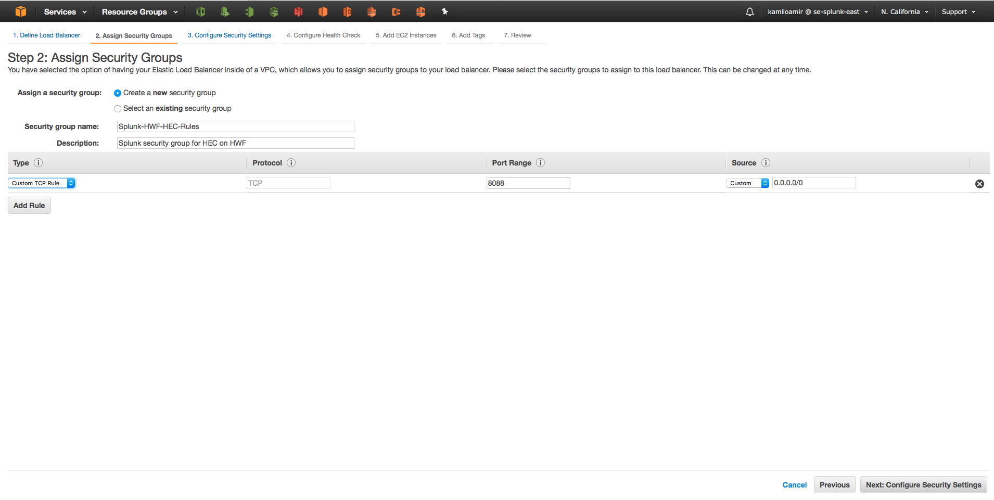
Setup Elastic Load Balancer (ELB)
Select Classic Load Balancer
Click Continue

Slide 20
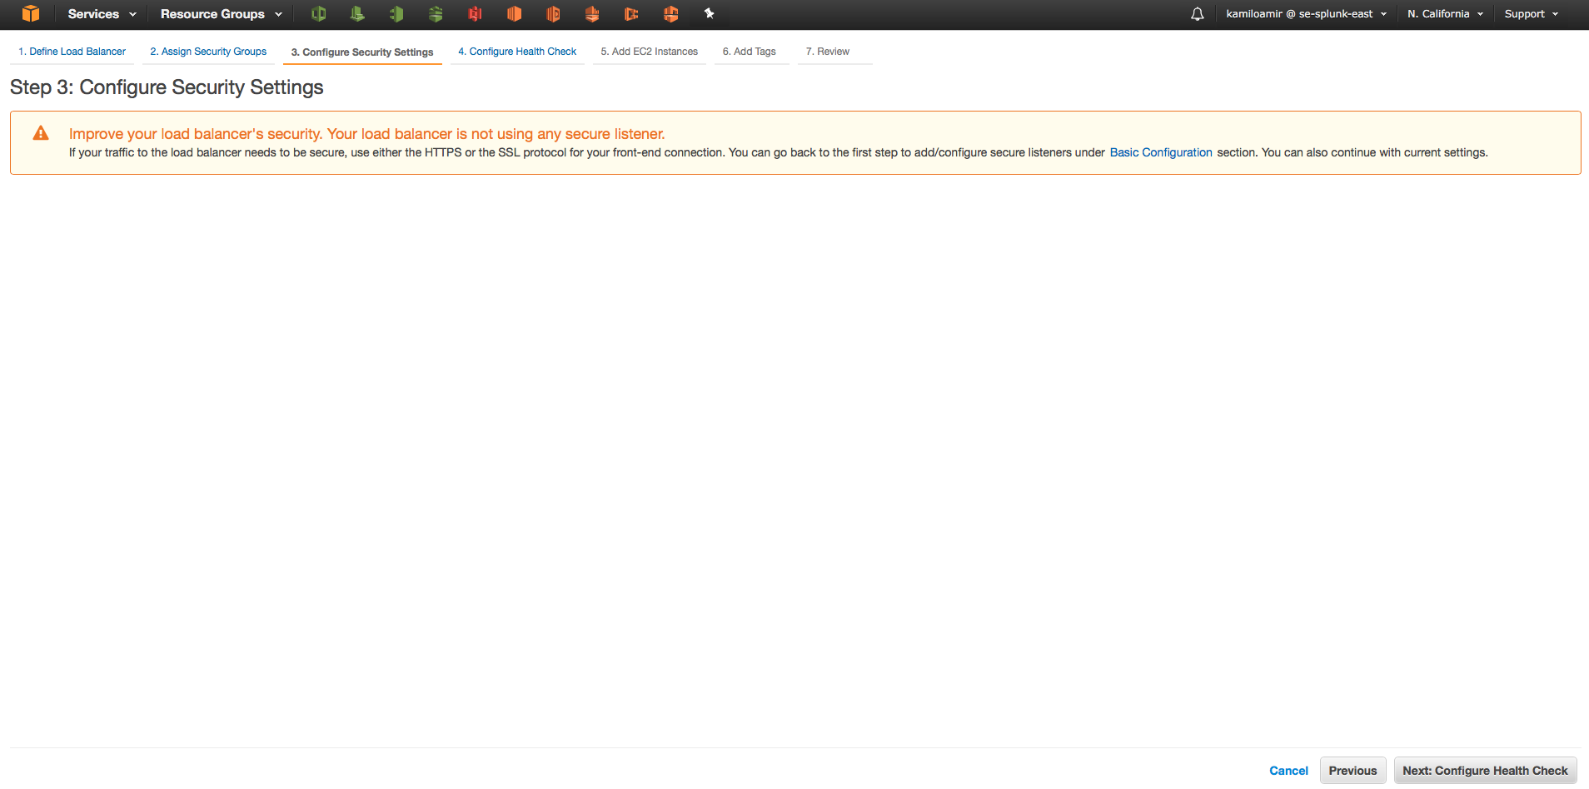
Setup Elastic Load Balancer (ELB)
Select Classic Load Balancer
Click Continue

Slide 21
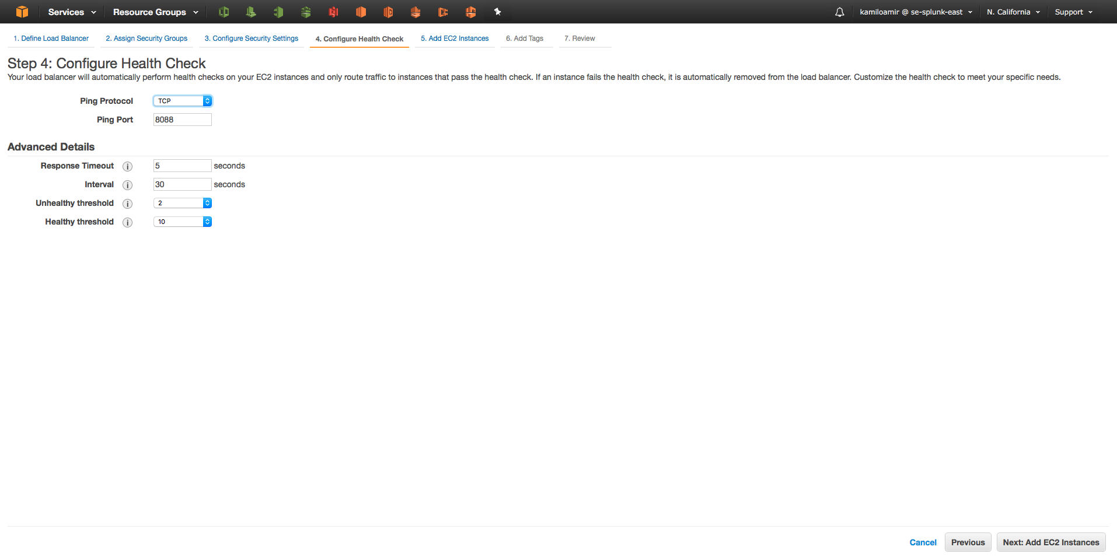
Setup Elastic Load Balancer (ELB)
Select Classic Load Balancer
Click Continue

Slide 22
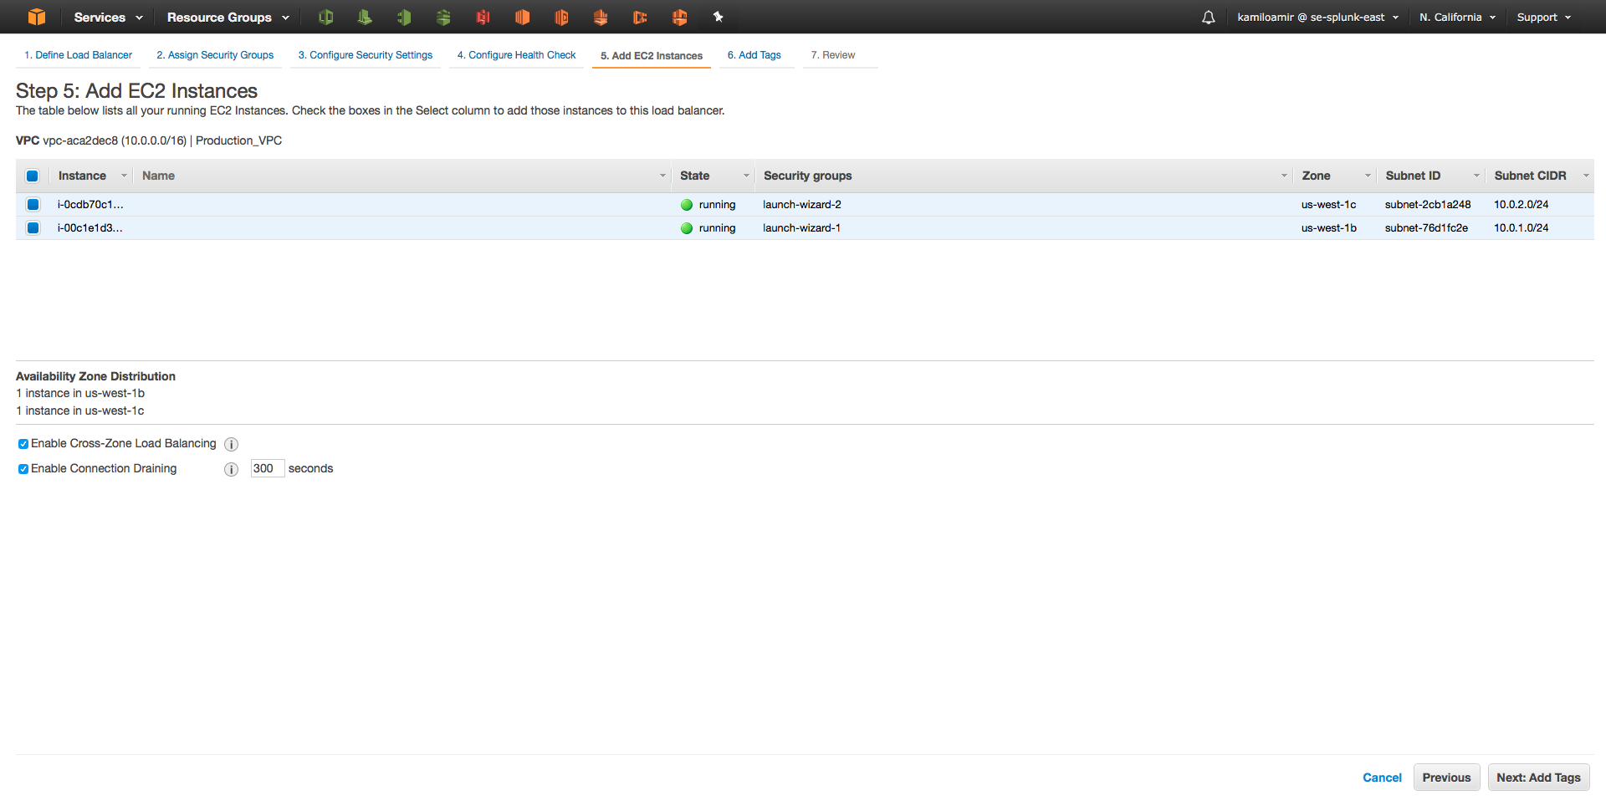
Setup Elastic Load Balancer (ELB)
Select Classic Load Balancer
Click Continue

Slide 23
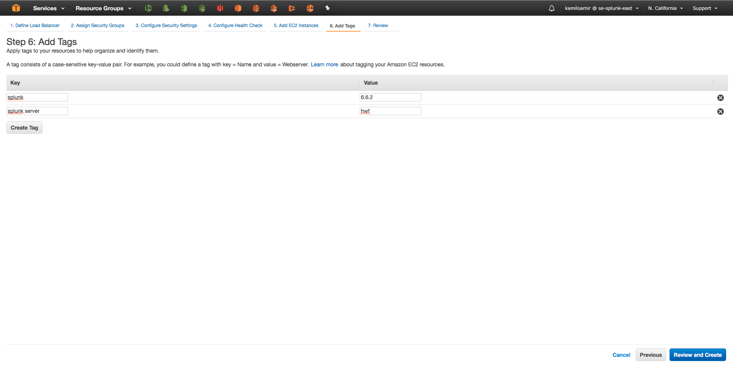
Setup Elastic Load Balancer (ELB)
Select Classic Load Balancer
Click Continue

Slide 24
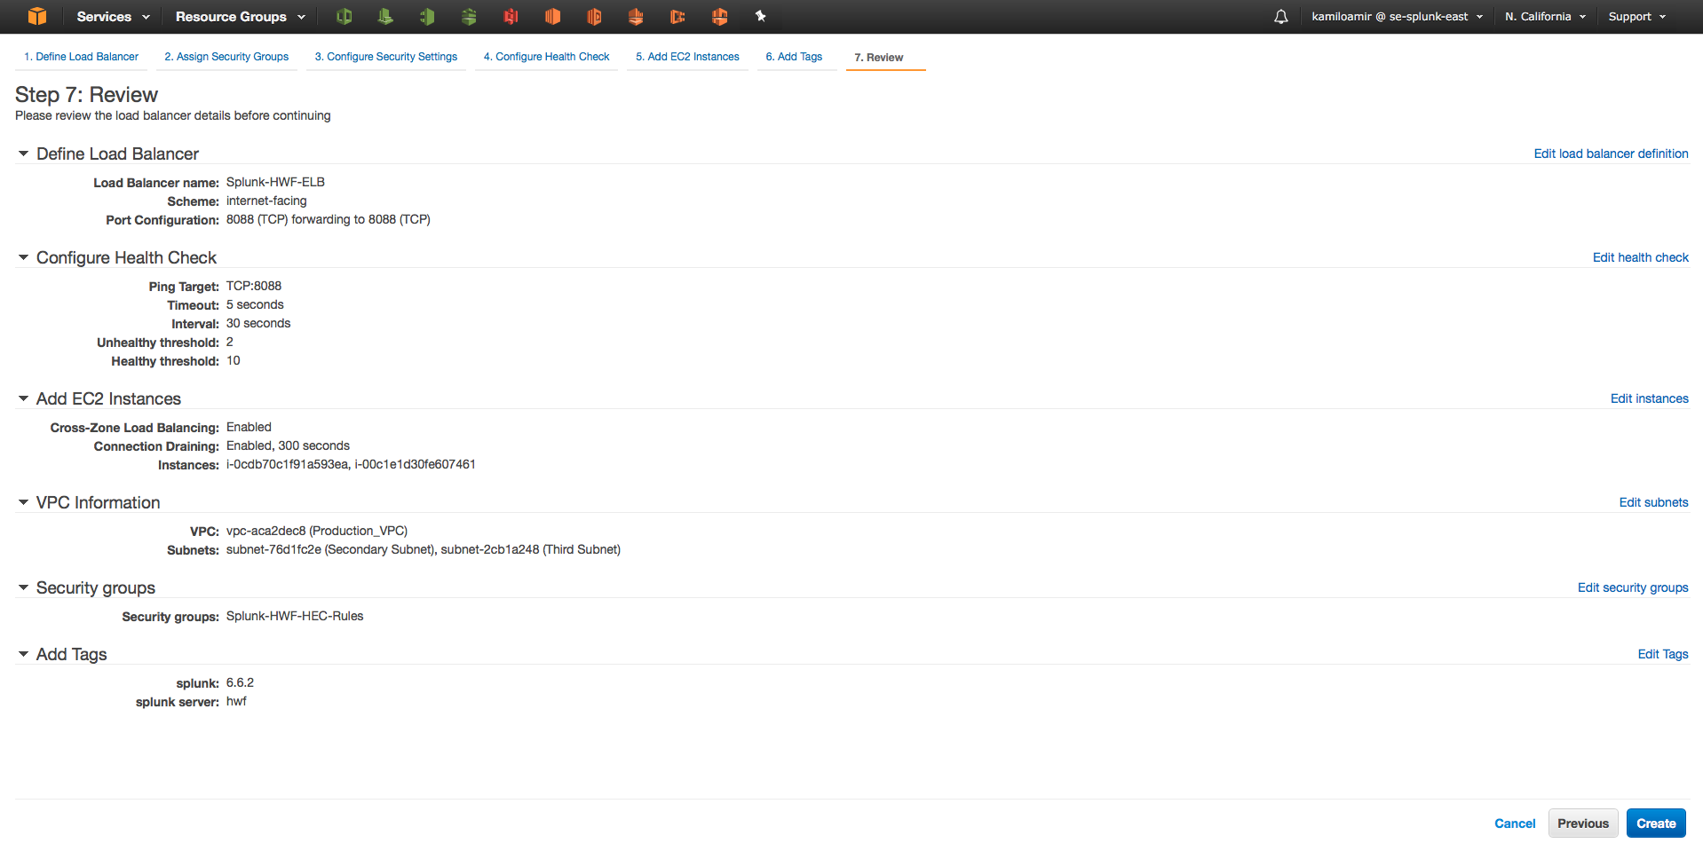
Setup Elastic Load Balancer (ELB)
Select Classic Load Balancer
Click Continue

Slide 25
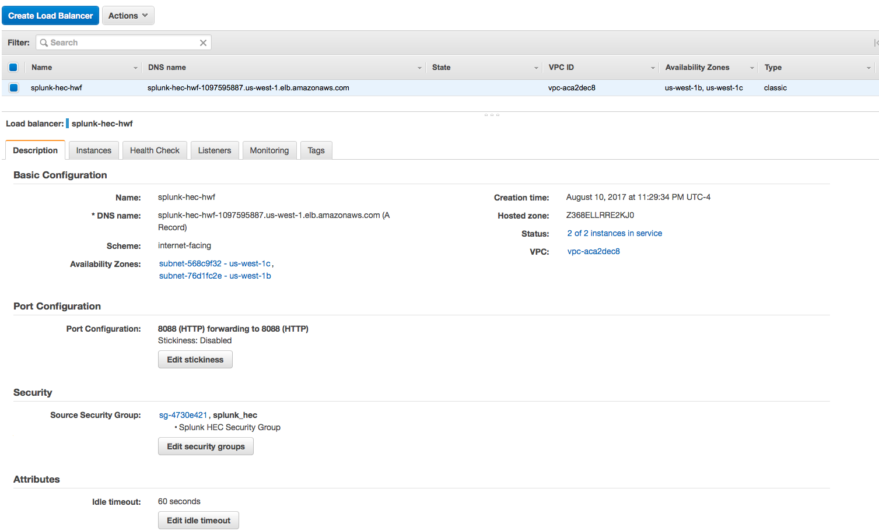
Setup Elastic Load Balancer (ELB)
Select Classic Load Balancer

Slide 26
Setup Splunk HWF / HEC
Setup the Splunk HWF and copy over the HEC token

Slide 27
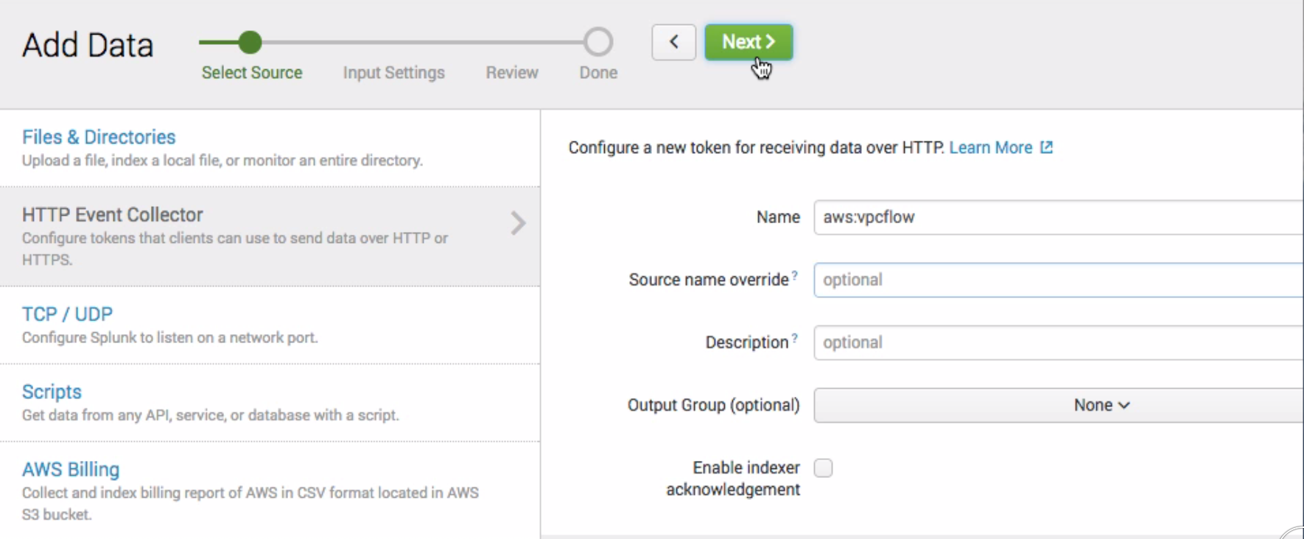
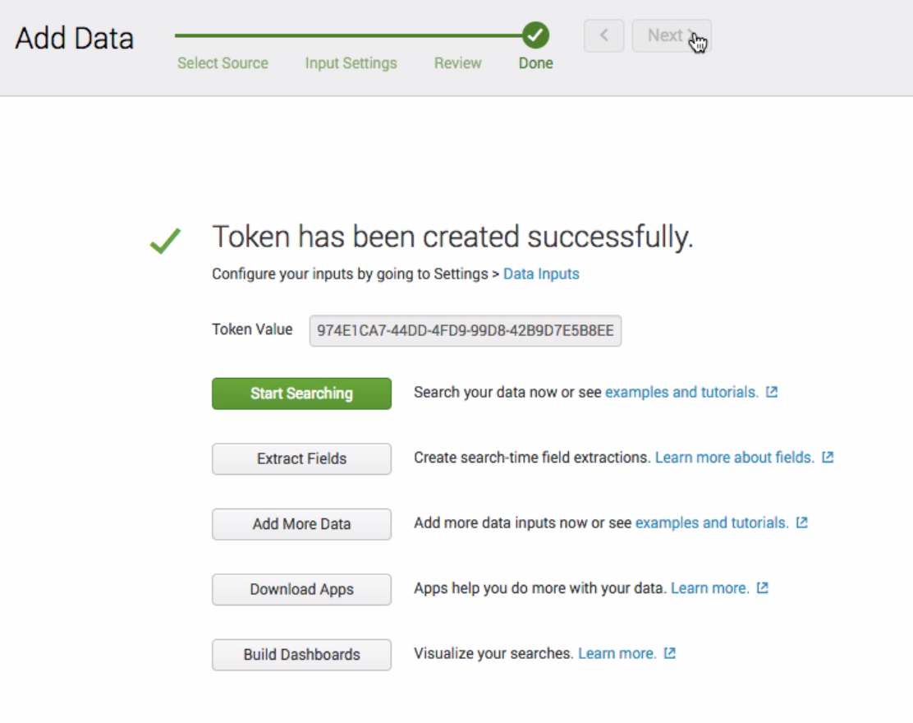
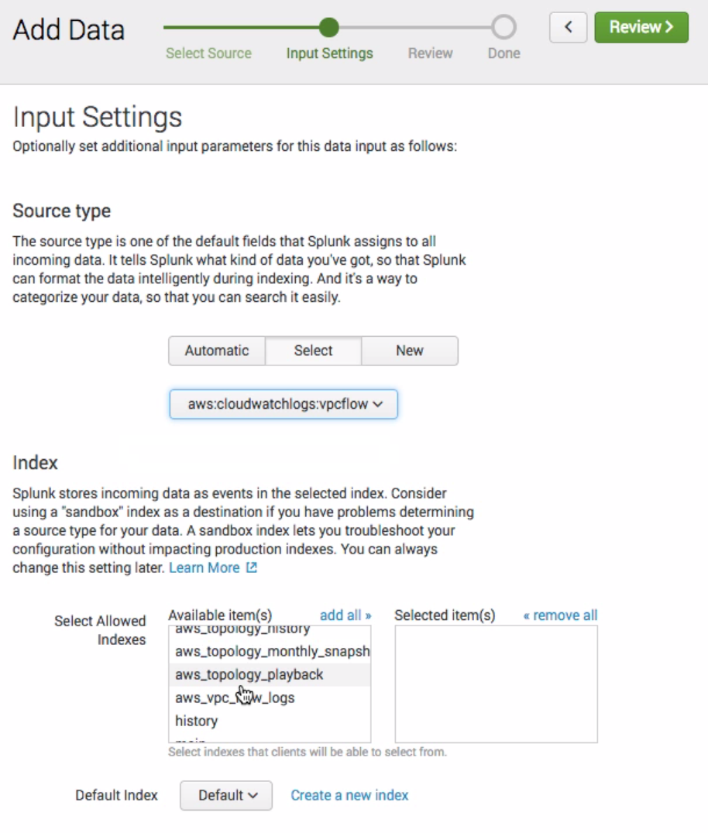
Create HEC Token
Create HEC Token on Primary HWF
Step 1
Step 3
Step 2

Slide 28
Copy Token to second HWF
http://dev.splunk.com/view/event-collector/SP-CAAAE73
SSH into primary HWF
Go to $SPLUNK_HOME/etc/apps/search/local
Open inputs.conf (vi inputs.conf)
Copy to same location on second HWF
Restart second HWF
[http://test]
disabled = 0
token = FC363996-7FB2-43A8-ACCB-F8B8CD29DD70
Sample Entry

Slide 29
Outputs.conf
Send data to indexers (or search head in this example)
$SPLUNK_HOME/etc/system/local/outputs.conf
Add Stanza:
[tcpout]defaultGroup = default-autolb-group
[tcpout:default-autolb-group]
server = <server>:9997
[tcpout-server://<server>:9997]
Make sure that the security group is open for 9997 TCP inbound from the HWF tier.

Slide 30
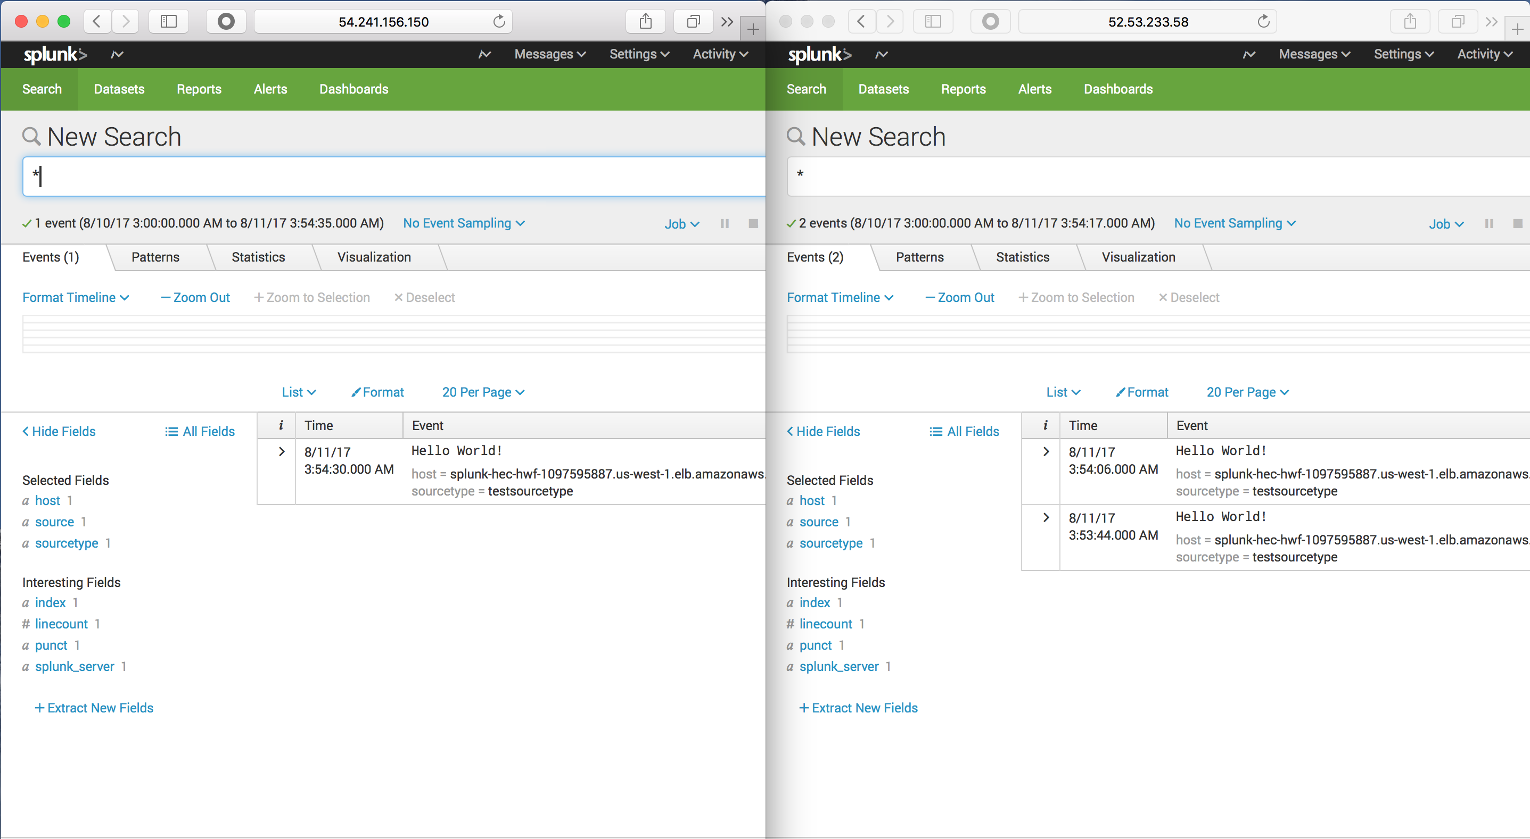
Test ELB
Run cURL command and test
See Module 5: Troubleshooting App, slide 6 for cURL commands
Check both instances and see that the ELB is sending data to both instances

Slide 31
Securing HEC with SSL
Use SSL Cert (not self-signed) to secure HEC
For production systems, make sure to use SSL certs
Upload SSL Certs to Amazon Certificate Manager
Copy Cert to both HWF in $SPLUNK_HOME/etc/auth/<domain_directory>
Certificate.pem
PrivateKey.pem
Docs for securing HEC :
http://dev.splunk.com/view/event-collector/SP-CAAAE6Q
http://docs.splunk.com/Documentation/SplunkCloud/latest/Data/UsetheHTTPEventCollector

Slide 32
Sending ELB Logs to S3 then Splunk

Slide 33
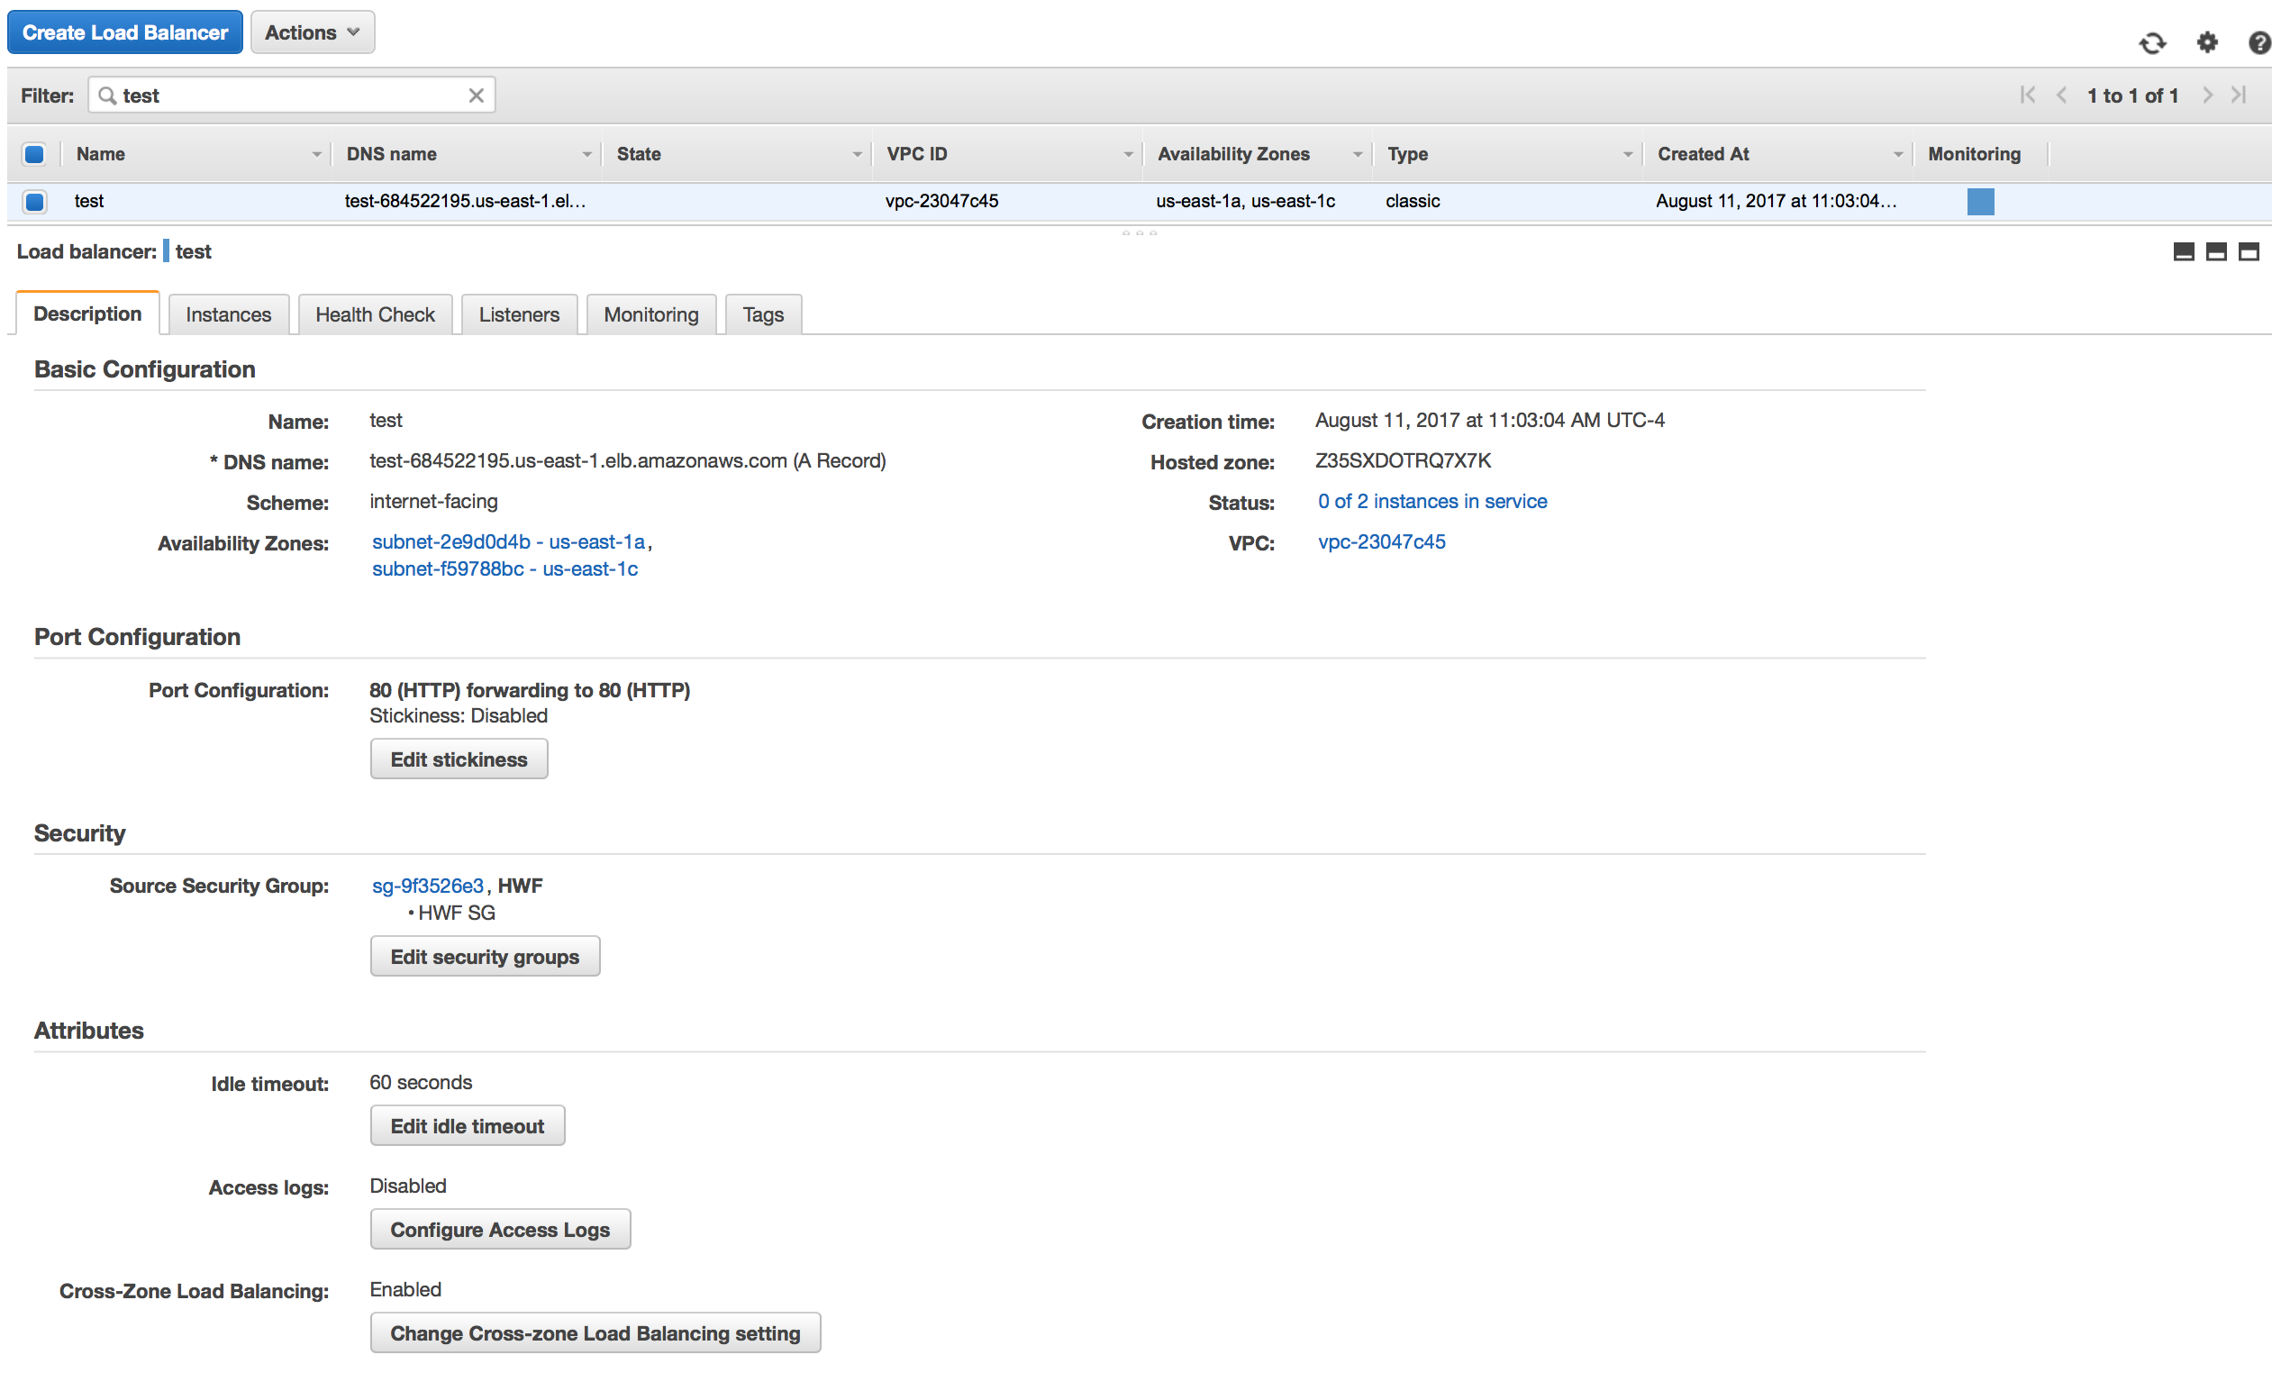
Send the Logs to S3
Scroll Down to Access Logs Setting
Scroll Down
Click Here

Slide 34
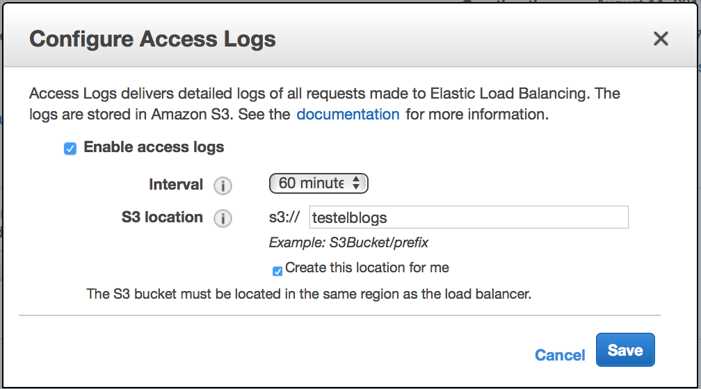
Send the Logs to S3
Make sure to use a unique S3 bucket name
Click here to enable access logs
Click Here to create new unique S3 bucket

Slide 35
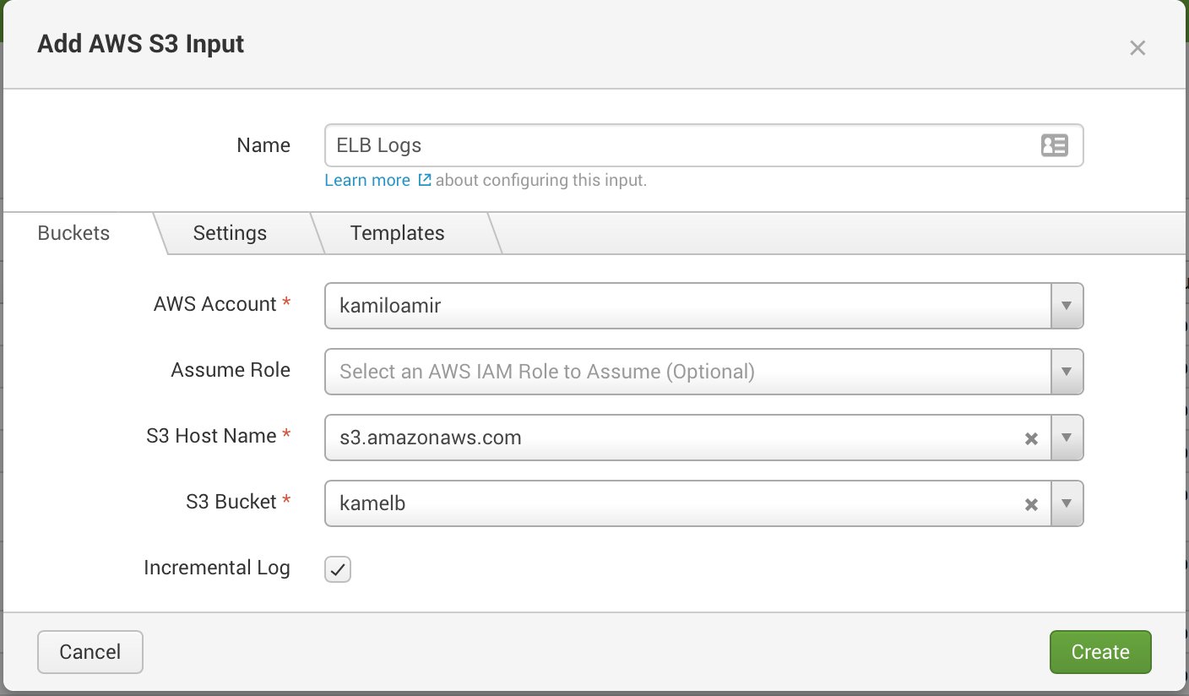
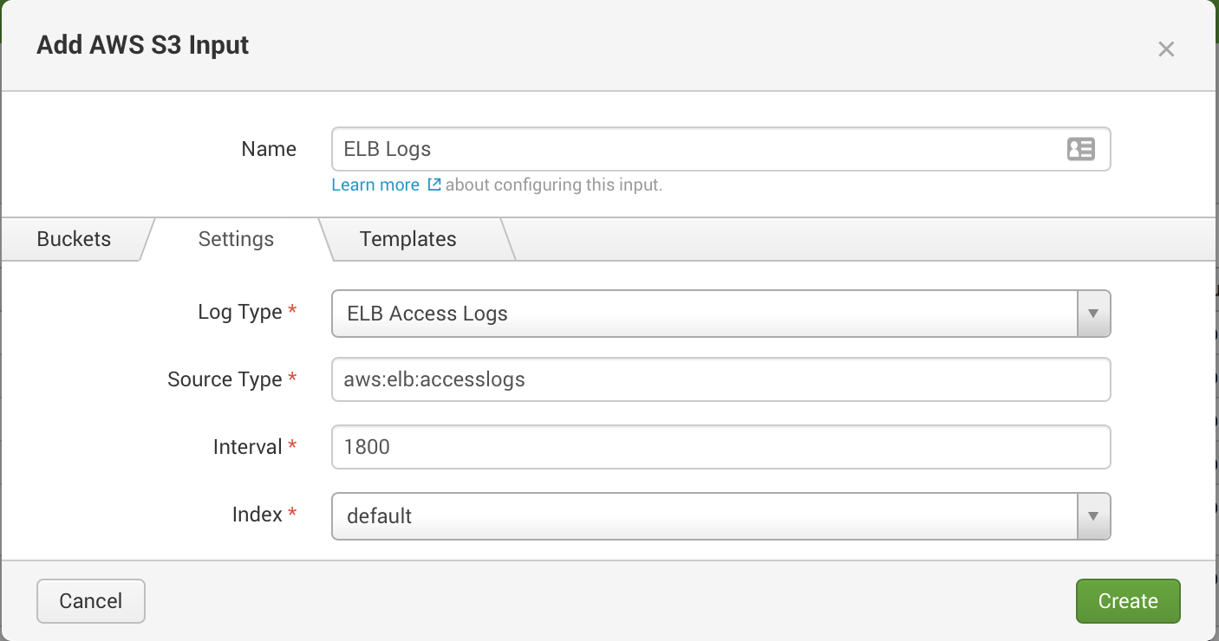
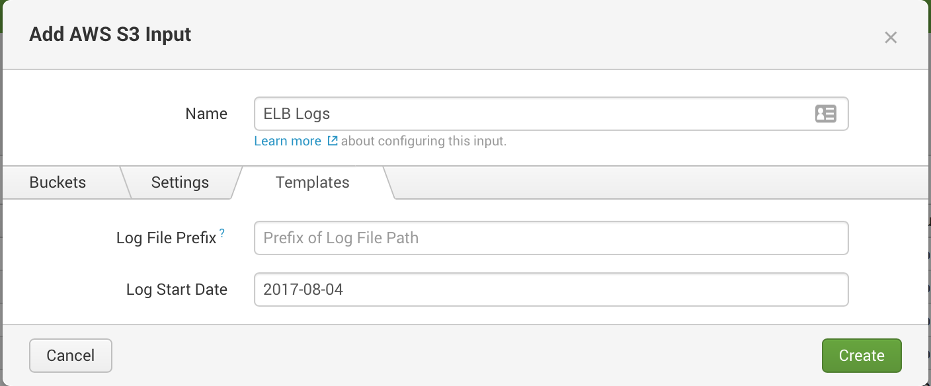
Setup Splunk: S3 Modular Input
Collect data from S3 bucket on an interval
S3 Modular Input
In the Add-on, click Create New Input
Select S3
Buckets (Tab)
Select the bucket with the ELB access logs
Settings (Tab)
Log Type: ELB Access Logs
Sourcetype: aws:elb:accesslogs
Interval: 1800 seconds (30 minutes)
Template (Tab)
Leave blank

Slide 36
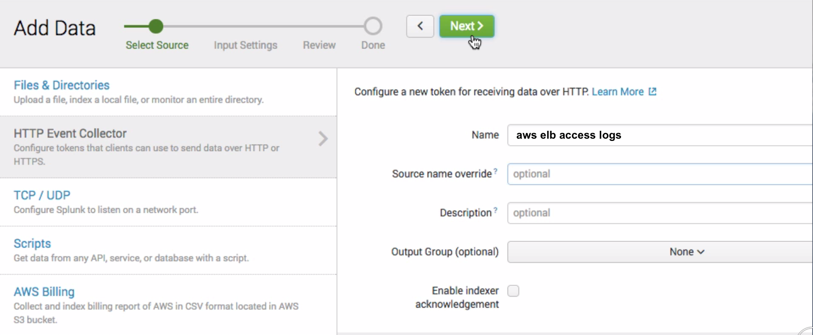
Setup Splunk: HEC token for ELB logs
Collect ELB Logs using HEC and Lambda Function
Splunk
Create new HEC input
Settings -> HEC -> Add New (Name it aws elb access logs
Set Sourcetype: aws:elb:accesslogs
Send to default index
(See Module 3, Slide 12 for details and visuals)

Slide 37
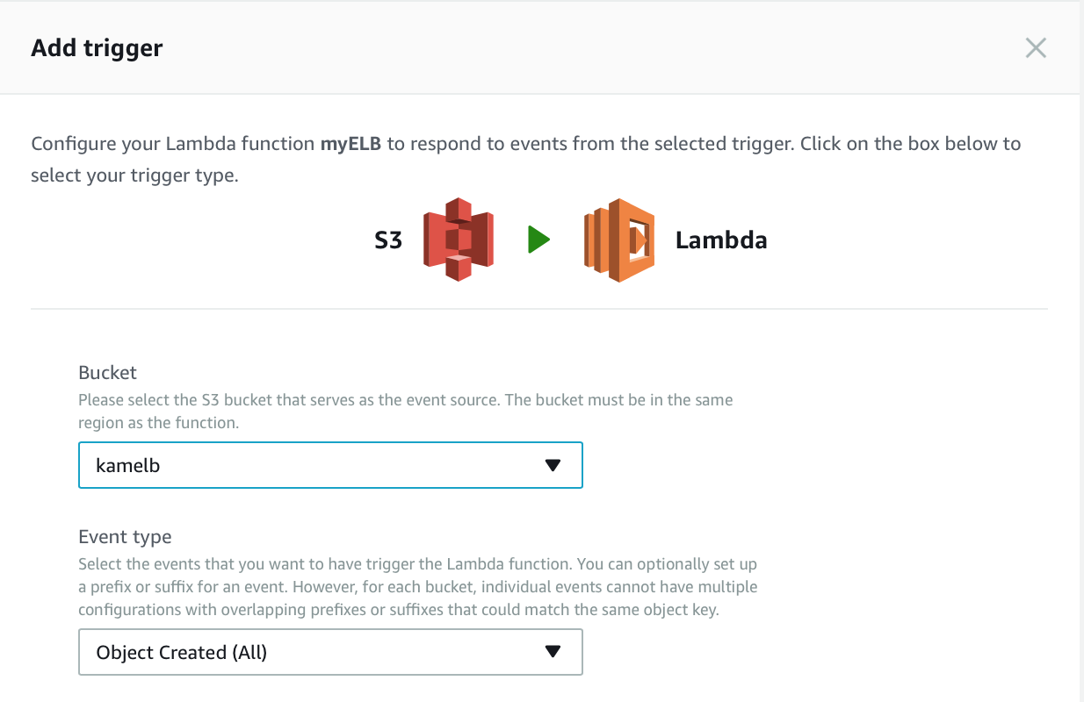
Setup Splunk: AWS Lambda S3 logging
Select splunk-logging blue print
AWS
Open Lambda -> Create New Function
Filter for “splunk-logging” blue print
Enable Trigger for S3 bucket ObjectCreated(ALL)
Enter ELB URL
Enter HEC token
(See Module 3, Slides 16-20)

Slide 38
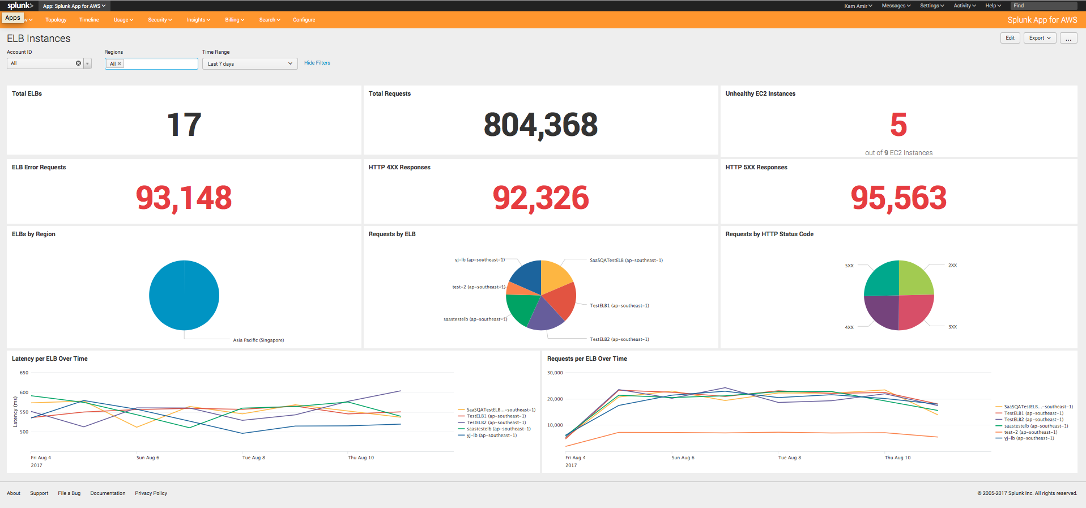
ELB Usage Page
Splunk App for AWS ELB Usage Page

Slide 39
Continue to Module 8: Migrating AWS TA between Machines

